Slide 1

The Applications of Relations
(Kustral’s algorithm and graph theory)
By Omar Monge
mongeoa3895@student.laccd.edu

Slide 2
Why I chose this?
Data analysis and effective programing requires to have an intuition of Discrete math and logic. I wanted to research how algorithms connect with symbolic logic so I could further my understanding

Slide 3
What theory and logic from discrete math apply to us?
Let’s say I am trying to determine the shortest path between all locations, networks, flights, etc.
How can I effectively communicate the information and how do I determine what the meaningful relationship is?

Slide 4


Network problem
If we have a collection of data that have a relationship to one another, how can we find what data(nodes or vertex) have special meaning. For example, if we scroll through facebook, how does facebook know who to recommend to add as a friend?
They sort and chose the closes or neighboring people who you might know based on a graph.
This requires a fundamental logic of binary relations.

Slide 5
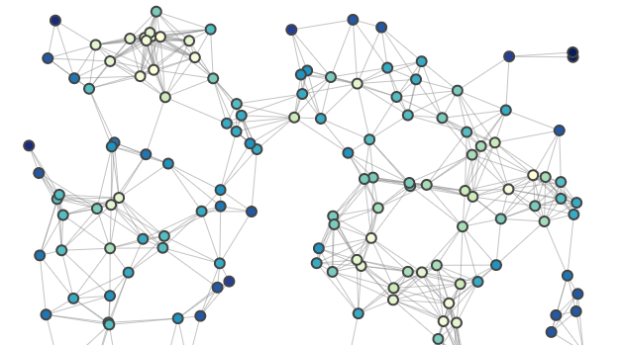
Look at this mess

Slide 6
What type of graphs are there?
First let’s figure out what kind of graph we are trying to represent:
Here are a few that are relevant to our problem:
A simple graph is when all vertices connect
A weighted graph is when the edges of the vertices have numbers, weights, data.
A directed graph is when vertices are going in one way with vectors. Undirected means the path flows all directions

Slide 7
Representing the Graph
There are three ways to represent a weighted graph:
•Representing Weighted Edges: Edge Array
•Weighted Adjacency matrices
•Adjacency lists –it combines adjacency matrices with edge lists

Slide 8
Possible solution..
We know that edge length is weighted because of the time, distance etc.
also assume that there are no restrictions to directions of edges. We can assume we can travel back and forth between connected vertices
Since this graph is undirected and weighted we can assume that we should use an algorithm that searches for a subset of the graph that is the smallest distance that connects all vertices.
Solution: create an algorithm to create a minimum spanning tree

Slide 9
Relations and graphs
By using relations covered in discrete math we can find adjacency list, edge lists, or arrays. Not only can we find ways to represent our graph but we can use these tools to find the minimum path in a given graph. We can create a MST which is a subgraph of a graph, we can apply logic from disjoint sets to help us understand.

Slide 10
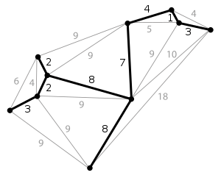
Minimum spanning trees
A tool to help us is an abstract construct called Minimum spanning Trees (MST).
It is the subset of the original graph and shows the minimum case of weights between each node
This is what we want to find given the entire collection of data. We also want NO unnecessary edges, meanwhile adding and combining edges to form a new tree.
We can perform this by using Union-find based approach.

Slide 11
Kruskal and Relations
What Kruskal’s algorithm essentially is:
1) making an empty set in which to add the minimum edges, then we sort the edges of the graph
2) check if the vertices aren’t being repeated. We need to perform union operation where the collection of vertices don't repeat,
performing an intersection of the two sets there should be no difference

Slide 12
Disjoint set intro
Disjoint operation is a Union-find algorithm, where we perform a Union binary relation, in which to make sure elements don’t repeat.
Disjoint sets provide easy solutions, they are very good at handling problems where we have to deal with equivalence relations, where we can’t repeat elements.
These are very useful for creating adjacency lists.

Slide 13
Disjoint Operation
Ex. a set with {a,b,c} and a separate set with {d,e,f} are disjointed
If we perform a Union on both of these sets we should end up with {a,b,c,d,e,f}
Because our problems requires that we sort first and then make sure no unnecessary edges are repeating this makes it easier to subset and partition the set of all the edges and weights

Slide 14
Equivalence relation
Equivalence classes are disjoint sets where the equivalent relation R on a given set A, denotes a as [a], [a] is a partition of set A with respect to a.
[a] = {x ∈A ∣x R a}
An equivalence class is when disjoint sets in a union make up the original set. They are a partition of Set A, if R is over A, then every a∈A has an equivalence class

Slide 15
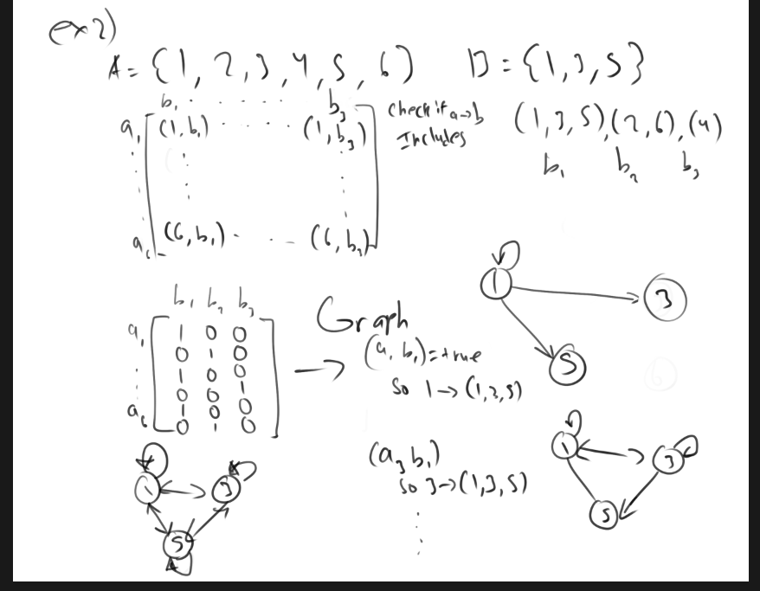
Another example with an Equivalence class
This is a binary relation with R being a=b, aka equivalence relation.
Ex1) Set A = {1,2,3}
R = {(1,1),(2,2),(3,3),(3,2),(2,3)}
[1]R = {(1,1)} = {1}
[2]R = {(2,2),(3,2),(2,3)} = {2,3}
[3]R = {(3,3),(3,2),(2,3)} = {3,2} = {2,3} = [2]
Let Set B be the Partition of Set A where the subsets are an equivalence class
Ans: B1 = {1}, B2= {2,3}

Slide 16
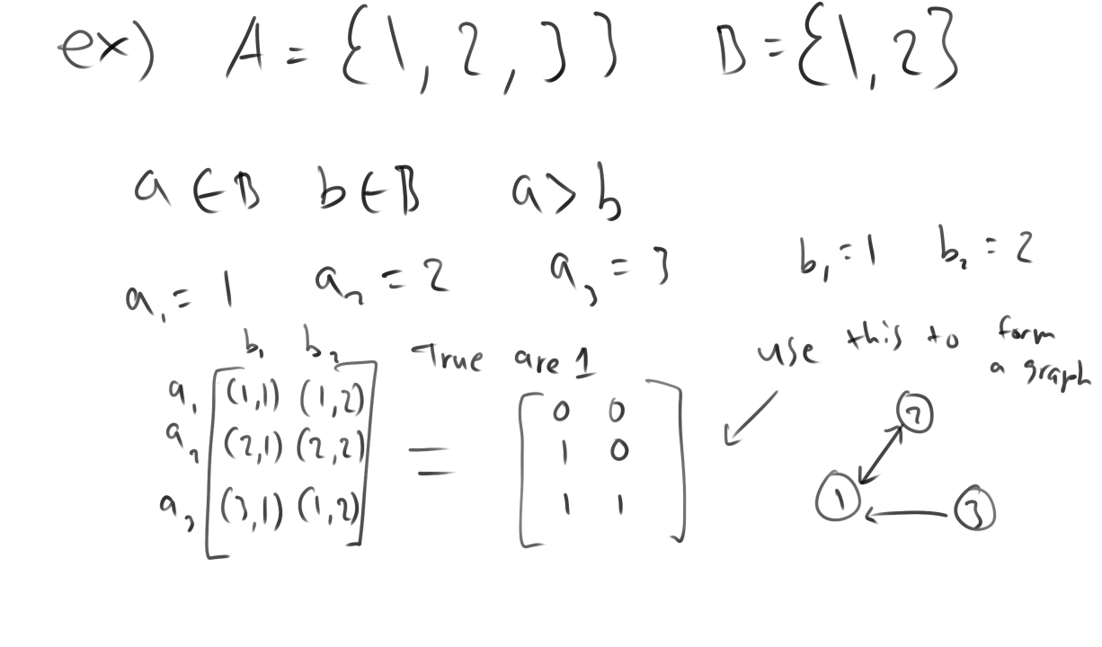
Finding relations and displaying graphs
In this example instead of using a=b we are using the relation a>b.
There are many kinds of binary relation but the one we are interested is equivalence because we can disjoint the set without pairing unnecessary edges

Slide 17
Disjoint-set Algorithm
Kruskal’s algorithm uses concepts from another abstract data structure called Disjoint sets, also called union-find.
function Find(x) is
if x.parent ≠ x then
x.parent := Find(x.parent)
return x.parent
else
return x
end if
end function
function Union(x, y) is
// Replace nodes by roots
x := Find(x)
y := Find(y)
if x = y then
return // x and y are already in the same set
end if
// If necessary, rename variables to ensure that
// x has at least as many descendants as y
if x.size < y.size then
(x, y) := (y, x)
end if
// Make x the new root
y.parent := x
// Update the size of x
x.size := x.size + y.size
end function
function MakeSet(x) is
if x is not already in the forest then
x.parent := x
x.size := 1 // if nodes store size
x.rank := 0 // if nodes store rank
end if
end function

Slide 18
Kruskal’s Algorithms
Kruskal's algorithm pseudo code
F:= ∅
for each v ∈ G.V do
MAKE-SET(v)
for each (u, v) in G.E ordered by weight(u, v), increasing do
if FIND-SET(u) ≠ FIND-SET(v) then
F:= F ∪ {(u, v)} ∪ {(v, u)}
UNION(FIND-SET(u), FIND-SET(v))
return F

Slide 19
What about shortest path from a source?
In this case we have to use distrijia’s algo, since disjoint and kuscral alg are for finding MST
Distrijia is finding a path between two vertices or a source

